Slide 1
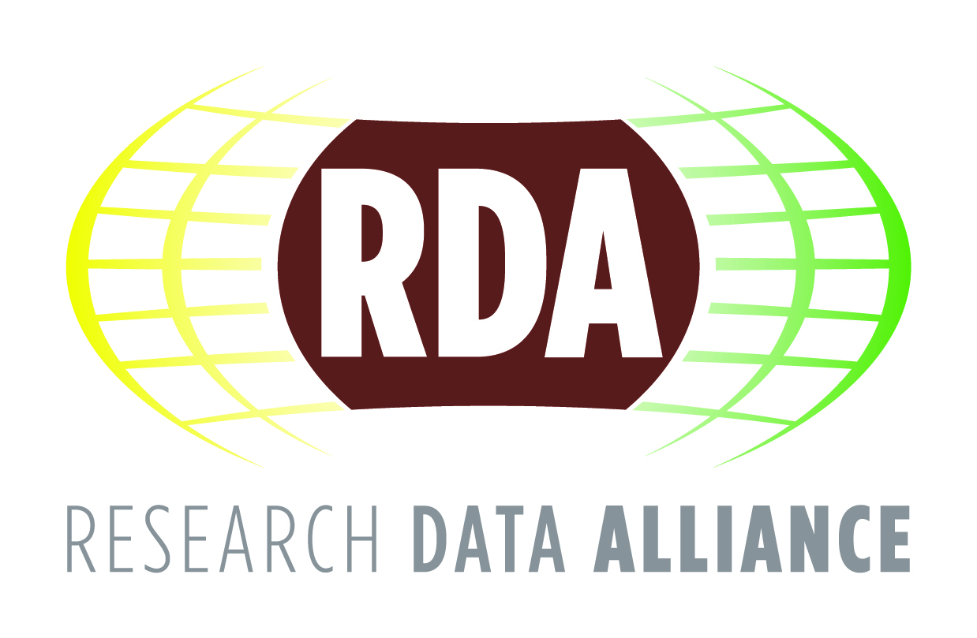
The Value of the RDA for Organisations Performing Research
The research Data Alliance’s vision is researchers and innovators openly sharing data across technologies, disciplines, and countries to address the grand challenges of society

Slide 2
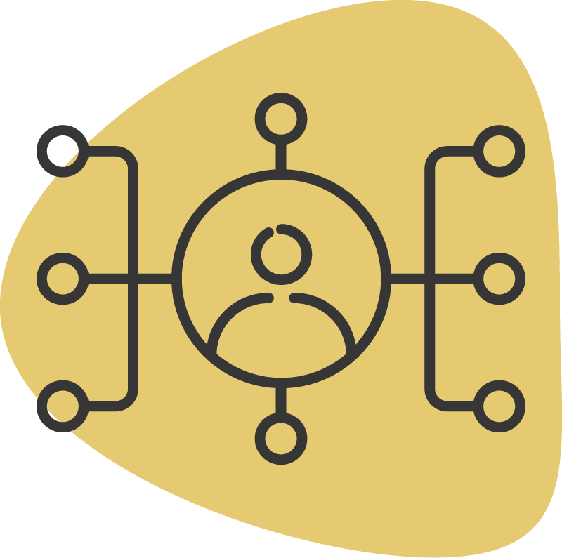
Important distinction between the two major components of the Alliance
The Work of RDA is done by the volunteer community through self-formed, focused Working Groups and exploratory Interest Groups to build the social and technical connections or bridges.
The Business of RDA is to support that community and facilitate the building and using of the bridges that enable open sharing of data.
There are thus a number of different ways for an organisation performing research to engage with the Research Data Alliance.

Slide 3
Why should organisations performing research engage with RDA?
Every research performing organisation has specific responsibilities around the management and quality of research data outputs created at the organisation.
Shaping and adopting international agreements that affect management and quality provide a way for the organisation to manage risk and create strategic advantage.

Slide 4
Solutions and benefits for organisations performing research and their staff
RDA offers a neutral forum for research data interoperability;
RDA is a global platform and network offering unique interactive and collaborative opportunities;
RDA groups produce guidelines, tools, methods and infrastructures for locating, understanding and reusing data;
Access to an international forum facilitating the harmonisation integration and/or implementation of standards and methods for data interoperability;
Opportunities to partner with expertise to augment specific communities of interest and corresponding data interoperability solutions;
A means of managing institutional risk regarding data management and data quality obligations;
Access to an extraordinary network of international colleagues and organisations
​

Slide 5
How can your organization engage with RDA?
Become a Sponsor of RDA Business and/or Work activities;
Become a Supporter by contributing to the Business of RDA;
Join as an Organizational Member with an annual subscription fee;
Become and Individual RDA community member, free of charge;

Slide 6
RDA Sponsor and Supporter Options
Sponsorship of RDA Plenary Meetings
Organisation of Research Data Meetings
Support of Data Expert/Fellow/Early Career Programmes
Test, Adopt and Implement Projects/Pilots
Support of Travel to RDA Plenary Meetings
Establishment of RDA Data Awards/ Scholarships
Organisation of RDA Training/Events

Slide 7
RDA Plenary Meeting Sponsorship
RDA Plenary Meetings:
are an opportunity for the RDA community members to discuss possible new topics, advance Working and Interest Group activities, and to conduct RDA business;
serve as important milestones in the life of the Working and Interest Groups, especially in terms of achievements and outputs;
provide the opportunity for all the RDA coordination groups such as the Council, RDA Funders Forum, Secretariat, TAB, OA, OAB to interact with members on the current state, progress, achievements and future plans.

Slide 8
Organising Research Data Meetings
Organisations can support and run high-level events targeted at funders, research institutes, industry, etc.
They can focus on specific topics of global interest and importance.
RDA would be seen as an independent international forum for discussing and actioning these topics with organisations across the globe.
The organisation could consider proposing a topic and sponsoring one of the events.

Slide 9
Data Expert / Fellow / Early Career Programmes
RDA Europe early career programme specifically supports participation in RDA Plenary meetings by covering the costs (travel, subsistence, visa and registration fees).
RDA US has run Fellow programmes using funding from organisations to support 3-6 month activities which run before and after a plenary meeting.
All programme participants can showcase their data research activities at a Plenary meeting, in addition to other kinds of exposure to RDA members and groups.

Slide 10
Testing, Adoption and Implementation Projects / Pilots
Projects directly funded by organisations to date:
RDA US Adoption Grants
AGU / RDA US FAIR Data
RDA EU Collaboration Projects
RDA AU: Australian National Data Service (ANDS) 23 Research Data Things Programme

Slide 11
RDA plenary meeting travel support
Support the costs of RDA Community Members to attend RDA plenary meetings and do the Work of RDA, advancing the Working and Interest Group developments and deliverables.
Organisations wising to do this can open a call for expressions of interest focusing on a specific topic, discipline, domain, technology, etc.

Slide 12
RDA Data Awards / Scholarships creation of a programme to offer visibility and recognition to data excellence
Possible awards:
for innovative implementation of RDA outputs in SMEs / industry;
for excellent research conducted using RDA outputs (or the ICT Technical Specifications = Standards).
Scholarships could cover specific data science education in particular
domains etc.
An RDA Aware or Scholarship programme would be sponsored by an organisation, with the management of the programme to be under the RDA Foundation and thus the Foundation receiving financial support for administrative aspects.

Slide 13
RDA Training / Events
Creation of a datathon, hackathon, training course or series of focused events (including webinars).
Organised and supported by an organisation.
With the core objective being to raise awareness of and increase impact of RDA activities and outputs.

Slide 14
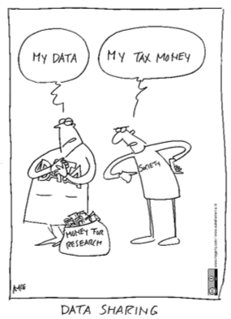
What does RDA do?
RDA is building the social and technical bridges that enable open sharing of data to achieve its vision of researchers and innovators openly sharing data across technologies, disciplines, and countries to address the grand challenges of society. ​
RDA members collaborate together across the globe to tackle numerous infrastructure & data sharing challenges related to:
Reproducibility
Data preservation
Best practices for domain repositories
Legal interoperability
Data citation
Data type registries
Metadata
So much more!

Slide 15
What is the benefit to RDA of engaging with organisations performing research?
Augmenting the worldwide network of international, expert data and information professionals collaborating on research data challenges with organisational representatives;
Contributing to the development and maintenance of high-quality Outputs and Recommendations to solve global, current and relevant data interoperability problems;
Creating and shaping RDA's future Recommendations and Outputs, ensuring it is addressing real-world challenges;
Proposing and developing solutions as well as use cases to actual data interoperability challenges;
Acting as RDA adopters who amplify, direct, and promote RDA Recommendations for the greatest effect and utility in their communities.

Slide 16
Organisations Performing Research and RDA
Please use these slide sets for your own use.
For the complete RDA Value statement for Organisations Performing Research click here
Stay up to date with RDA:
Email - enquiries@rd-alliance.org​
Web - www.rd-alliance.org​
Twitter - @resdatall​
LinkedIn - www.linkedin.com/in/ResearchDataAlliance​
Hilary Hanahoe, Secretary General RDA – hilary.hanahoe@rda-foundation.org
Twitter - @hilaryhanahoe

